Slide 1

STUDIO
Waweru Brian

Slide 2
Table of contents
Introduction​
Primary Goals
Guiding ​Questions
Finding
Conclusion

Slide 3
Introduction
Should Microsoft venture in the Film industry?
Short answer: Yes!
Film production is enormously lucrative venture for any company with a strong brand presence and standing. Microsoft would indeed have great chance in market penetration, recognition and revenue if it were to partake in this film production domain.
This study shows us why Microsoft should build a Film Studio and where exactly it should start.

Slide 4
BUSINESS OPPORTUNITIES ARE LIKE BUSES. THERE'S ALWAYS ANOTHER ONE COMING.
“
”
Richard Branson

Slide 5
PRIMARY GOALS Guiding questions
Understanding the informing data.

Slide 6

Objectives
GENERAL OBJECTIVE:
Does Microsoft need to have a Studio of its own? Where and how should it commence its efforts in the industry?
SPECIFIC OBJECTIVES:
Which Films performed well in domestic and worldwide markets base on: genre, language and region.
(i) Genre
(ii) Original titles perform in the market?
(iii) Language
(iv) Region

Slide 7

EDA and data cleaning
The vast pool of our study data comes from the world’s most trusted and respected sources of film information. This includes, but not limited to Box Office Mojo, IMDB, Rotten Tomatoes, TheMovieDB and The Numbers collected over a 12 year period.
What we have found out:
If we were to suggest the best way to approach launching The Microsoft Studio it would best to check: -
To choose a more recent and fitting timeline for inspection.
Which Film genres performed well in BoxOffice (markets)
Which Language performed well
(iv) Whether or not original film had a good performance in market.
(v) Which regions performed well

Slide 8
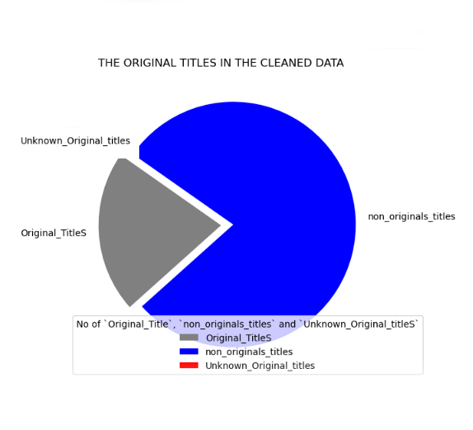
Here is what we found out
In Data Cleaning, we had
Over 287, 000 films produced over the period of study and we worked on a robust 19,035 film we a labyrinth workable information.
There were Original films, or remakes of older films production of films. There number of Remade Films; See figure 1
The study encompassed production of film for 10 years; from 2010 to 2020.
Original Titles
See performance in markets in the next slide
Figure 1

Slide 9
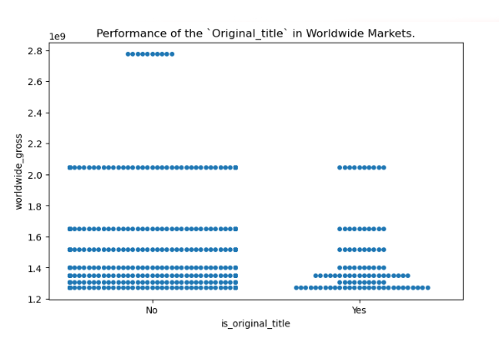
Cont.. Original films
INFERENCE:
It appeared that Old films did well in the worldwide market that new film production.
This is clearly seen in Figure 1.1 with the ‘No’ category showing higher earnings globally.
Figure 1.1

Slide 10
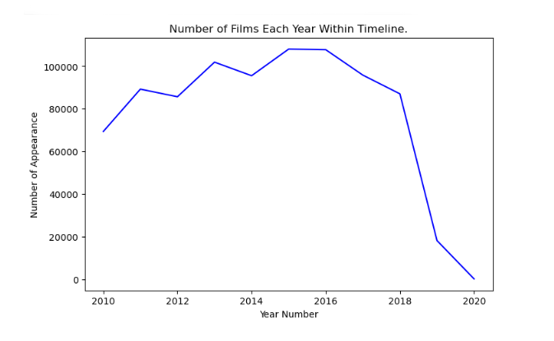
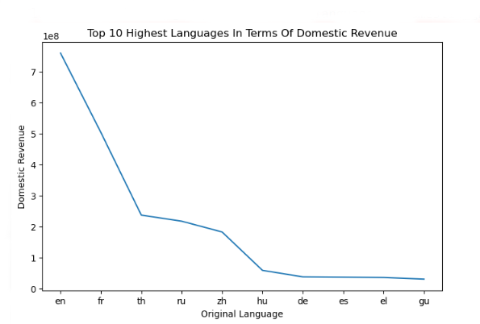
Film and TimeLine
The number of Films produced has fallen drastically. Pointing out there is a huge opening in the Film industry. See Figure 2
Figure 2
The dominant languages of Top 10 frequent languages were English and French. See Figure 3
Figure 3

Slide 11
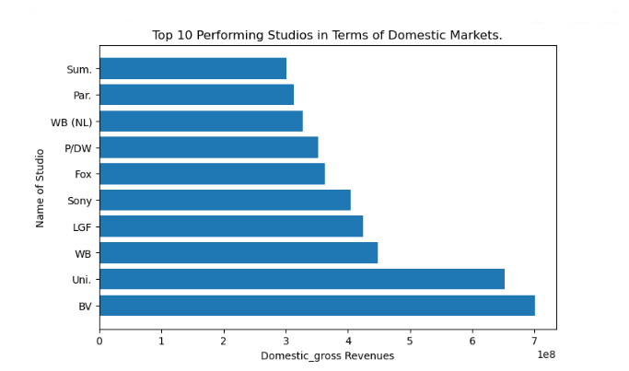
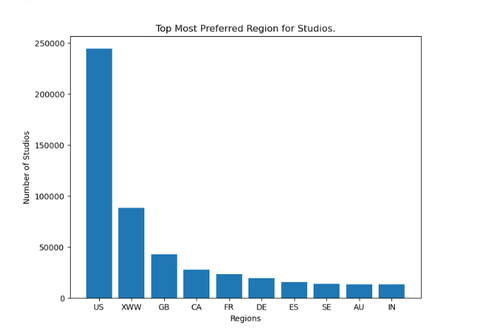
Best studios along regions
The Top biggest player in number of Studios `BV` and `Uni` are the Best Performing Studio thus far. See Figure 4
Figure 4
The most preferred Region in number of Studios was seen to be `US` and `XWW` as seen in Figure 5
Figure 5

Slide 12
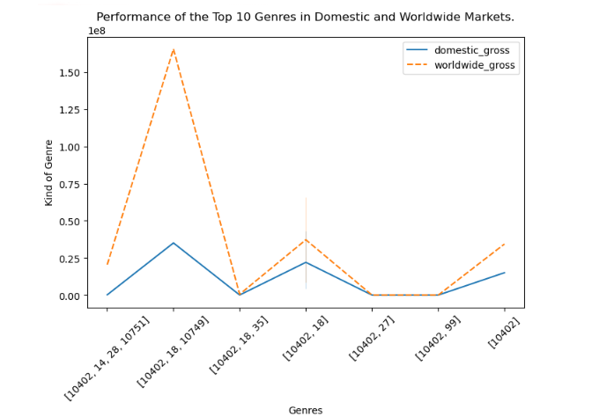
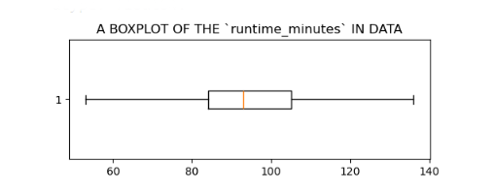
GENRES
The Best performing genre in ether markets were Drama, Action, Fantasy, Music and Romance. See Figure 7.
Best film
Runtime
The Average and best performing length of film was 94 minutes as seen in Figure 8.
Figure 7
Figure 8

Slide 13
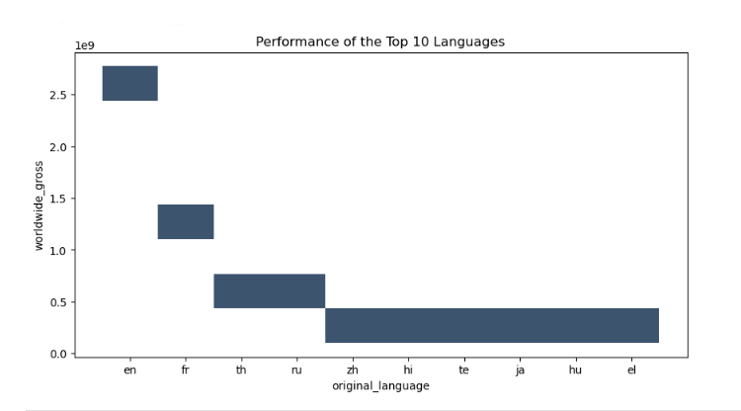
language
INFERENCE:
From this analysis, it was clearly shown that the top 10 performing languages included ‘English’, ‘Thailand’, ‘French’ and ‘Russian’.
See Figure 9
Figure 9

Slide 14

Recommendations
Original Titles: Remakes of old films perform better in overall markets. The best choices of film productions should be not be new film but a remodeling of old films.
Genre: based upon the analysis we found out that Drama, Action, Fantasy, Music and Romance. A choice of production of any of this genres would receive a positive reception in the market.
Region: The best choice of region to set up a Studio was found to be either in : `US`, `XWW` or `GB`.
Language and Runtime: The most occurring languages that performed well were: ‘English’, ‘French’, ‘Thailand’ and ‘Russian’. Any choice of these languages recommended for any film production of roughly 94 minutes of runtime length.

Slide 15

SUMMARY
Microsoft Should get into Film Production business by setting up studio in
Producing a Remodelling of Old Films, of the genres: Drama, Action, Fantasy, Music or Romance composed of either of these langauges: ‘English’, ‘French’, ‘Thailand’ and ‘Russian’ and runtime length of roughly 94 minutes.

Slide 16
THANK YOU

